Slide 1

Welcome to Second Grade
Welcome to Second Grade
Second Grade Staff
Second Grade Staff
Mrs. DeVincent
Mrs. Cook
Mrs. Kirby
Mrs. Reif
Ms. Taylor
Mrs. Chen
Mrs. DeVincent
(Ms. Harshman)
Ms. Ebbe
Mrs. Kirby
Mrs. Marsico
(Ms. Mulvey)
Mrs. Pisca
Ms. Taylor
Mrs. Chen
Notes:
Introduce the team

Slide 2


SJLES Behavior Expectations
SJLES has three school wide behavior
expectations that are reinforced daily in
all areas of the school:
    Be Respectful
    Be Responsible
    Be Ready to Learn
Notes:
Discuss the school wide behavior quickly and discuss the incentives I use in the classroom.

Slide 3

Our Daily Schedule
Morning Meeting/
Movement
Reading Groups
Writing
Vocabulary/Word Study
Recess and Lunch
Related Arts
Content
Math
Dismissal
Notes:
Go over the daily routine

Slide 4

Flexible Grouping
In order to better meet the
individual needs of our
students, we use flexible
grouping in Language Arts and
Math.
You will be notified if your child
switches teachers.
Notes:
Discuss flexible grouping

Slide 5
Grading System
II
I – Completed independently with few or no mistakes.
W – Completed with assistance or completed independently with mistakes (demonstrating a need for assistance).
N – Understanding is not apparent.
Notes:
Discuss how this correlates with the report card

Slide 6



Reading
Whole group reading instruction
Small group guided reading instruction
We will be reading:
Literary and informative texts
We will focus on :
decoding, fluency, oral and written comprehension,
word study and vocabulary
Notes:
Walk through ELA

Slide 7
Writing
Personal narratives
Opinion writing /book reviews
Informative
We will incorporate the 6+1 writing traits throughout all writing instruction.
Written response to reading
The students will also be introduced to cursive letters at the beginning of the second quarter.
Grammar

Slide 8





Daily 5

Slide 9
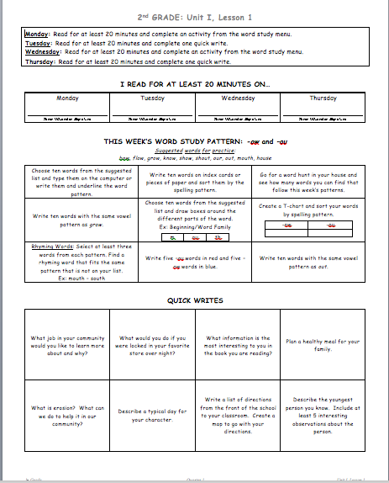
ELA Word Study Homework
The weekly ELA homework sheets include reading, word study, and writing assignments. The reading component encourages daily at-home independent reading, by asking students to read at least 20 minutes each night. The word study portion is aligned with weekly focus for the Building Vocabulary program. Two days a week, students will choose from a menu of activities that emphasize and reinforce the focus patterns, rather than individual spelling words. Finally, the students will select from a variety of quick writes on the two remaining days. These quick writes include prompts that address Social Studies, Science, and Health content, as well as response to independent reading and open-ended “fun” prompts.
Notes:
Discuss how we will model how to do the homework with students next week and the following week it will go home.
This is a county wide program. It is based on application and not rote memorization. We will have biweekly quizzes based on dictation sentences. WE are looking for capitalization, punctuation and applied spelling patterns.

Slide 10
Word Study Homework
Monday- Read for at least 20 minutes and complete an activity from the word study menu.
Tuesday- Read for at least 20 minutes and complete one quick write.
Wednesday- Read for at least 20 minutes and complete an activity from the word study menu.
Thursday- Read for at least 20 minutes and complete one quick write.

Slide 11
What Will Our Students Learn During Math?
Grade 2
Grade 3
Problem Solving
Place Value
Addition/Subtraction (to 1,000)
Fact Fluency
Time
Money
Measurement
Shapes and Figures
Problem Solving and Application
Place Value
Addition/Subtraction
Multiplication/Division including Fact Fluency
Fractions
Time
Area and Perimeter
Attributes of shapes

Slide 12

Where Can I Get More Information?
HCPSS SMART Pages
More information about the Common Core State Standards
Specific grade level standards
Optional activities you can do at home to support your student
http://smart.hcpss.wikispaces.net

Slide 13
Math Homework
We will have Math homework Monday – Thursday.
Math homework is provided by your child’s math teacher and sent home in his or her homework folder.
Please have your child practice math facts several times a week.

Slide 14

Health
Social and Emotional Health
Disease Prevention
Safety, First Aid, and Injury Prevention
Tobacco, Alcohol and Other Drugs
Nutrition

Slide 15
Understanding the Next Generation Science Standards (NGSS): Key Shifts
Asking Questions (for science) and defining problems (for engineering)
Developing and using models
Planning and carrying out investigations
Analyzing and interpreting data
Using mathematics and computational thinking
Constructing explanations (for science) and
  designing solutions (for engineering)
Engaging in argument from evidence
Obtaining, evaluating, and communicating information
K-12 science education should focus on BOTH content and skill, so that students know how to apply their factual knowledge.
Notes:
Listed on this slide are the 8 Science and Engineering Practices, outlined in A Framework for K-12 Science Education and included in each Next Generation Science Standard, grade K – 12.
The NGSS aligned curriculum developed by HCPSS was created with the intention to encourage student-centered instruction, with a focus on inquiry. The teacher, acting in the role of facilitator, delivers instruction infused with these 8 Practices so that students may learn not only the content knowledge, but also the behaviors and skills that that lead to success in the science and engineering career fields. In this way, the NGSS aligned curriculum supports HCPSS Vision 2018, by creating an engaging and vibrant learning environment in which every student is inspired to learn and empowered to excel.
A Framework for K-12 Science Education outlines three dimensions to science education:
Scientific and Engineering Practices (behaviors and habits of mind)
Crosscutting Concepts (unifying themes)
Disciplinary Core Ideas (big ideas, or topics)
The three dimensions work together like a braided rope in order to create instruction that is authentic and applicable for students.
The 8 Scientific and Engineering Practices describe the behaviors and habits of mind that are necessary to make students’ knowledge of content (Core Ideas) more meaningful.
The term “practices,” instead of a term such as “skills,” is used to stress that engaging in scientific inquiry and engineering design requires coordination both of knowledge and skill simultaneously.
Acquiring skills in these practices supports a better understanding of how scientific knowledge is produced and how engineering solutions are developed.
Such understanding will help students become more critical consumers of scientific information.

Slide 16

Science
Quarter 1 – Properties of Matter
Quarter 2 – Earth’s Features
Quarter 3 – Earth’s Changing Landscape
Quarter 4 – Relationships Within Habitats

Slide 17

Social Studies
Quarter 1 Comparing Communities
Quarter 2 People and the Environment
Quarter 3 Let’s Go Shopping
Quarter 4 Citizens in a Community

Slide 18
HCPSS Connect
Please go online and fill out emergency forms online.
We would like 100% completion as soon as possible.

Slide 19
Proposed Field Trip Dates and Information
Quarterly Book Reports – (TBD)
H.C. Fire Safety House Visit – (TBD)
Fairy Tale Ball – December (TBD)
Dentist Visit – February (TBD)
National Building Museum – (TBD)
Brookside Gardens – (TBD)
**Families can now pay online! More
information to follow!

Slide 20

Volunteering
Sign up slip is on your desk.
Rather work with students or clerical?
Clerical volunteer bin in the center of the pod.
Please remember to complete the child abuse training on the school website and turn in the certificate to me.

Slide 21


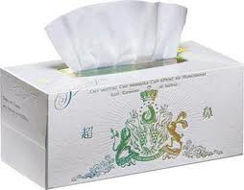

Donations
If you would like to donate supplies for the
classroom, some needed materials are:
Dry erase markers
Tissues
Sticky notes
Sandwich baggies
.
All donations are appreciated!
http://i1317.photobucket.com/albums/t634/[URL=http://media.photobucket.com/user/lawsonteamestudents/media/ploc_zpsf9c9af0c.jpg.html][IMG]http://i1317.photobuckt.com/al
bums/t634/lawsonteamestudents/ziploc_zpsf9c9af0c.jpg[/IMG][/URL]/ziploc_zpsf9c9af0c.jpg

Slide 22

FYI
Blue communication folders are sent home and checked
daily. Please send any notes to your child’s teacher in
the blue folder.
We will provide a weekly update form the Friday of
every full week.
Please check our team website for
updates from our team.
Contact info…
School (410) 313-2813

Slide 23

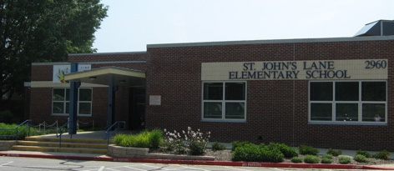

Questions?

